Slide 1
What is Salvation?
Understanding why Jesus is necessary to be saved

Slide 2
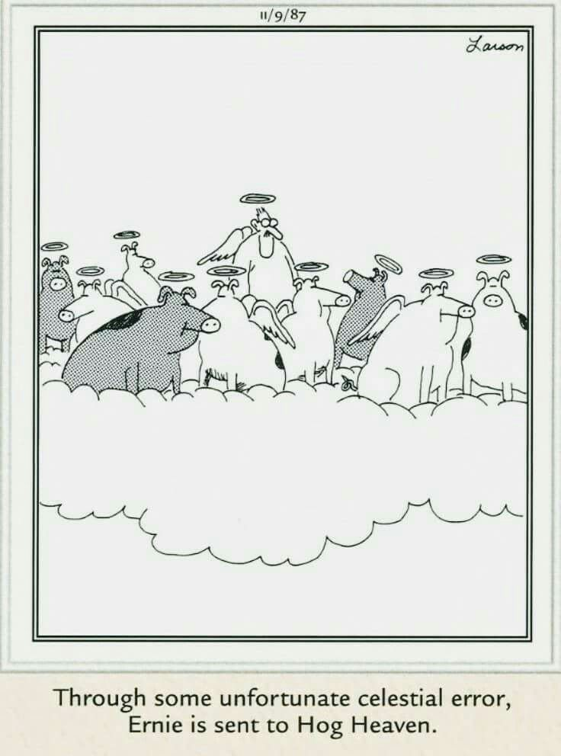
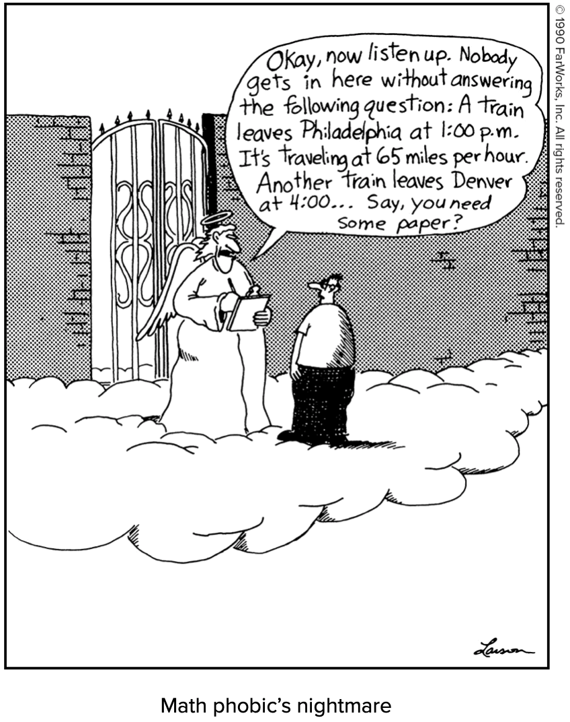
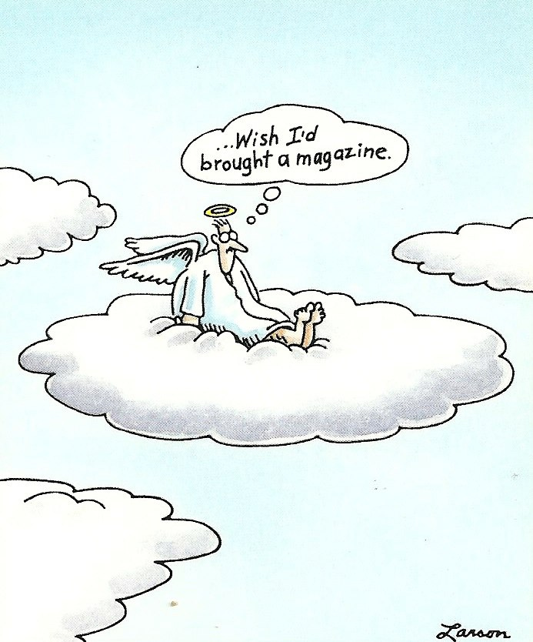
Popular images of heaven

Slide 3
Ticket to Paradise

Slide 4
Do the right thing…
One idea: Just, basically, be a nice person, you know?
The other extreme: Damnation awaits anyone who breaks the least of the rules!
Problem: Where is Jesus in these ideas?

Slide 5
Salvation is a Christian mystery
My Disclaimer
This description is based on the thought of the early “Church Fathers”

Slide 6
What is a Christian understanding of salvation that puts Christ at the center?
Salvation=liberation from sin and its consequences
Two of the main consequences of sin:
Separation from God
Death

Slide 7
Separation and Death
To Church Fathers, separation from God was the cause of death:
St. Athanasius of Alexandria:
“For transgression of the commandment was turning [humanity] back to their natural state, so that just as they have had their being out of nothing, so also, as might be expected, they might look for corruption into nothing in the course of time.”
“Out of a former normal state of nonexistence, they were called into being by the presence and loving-kindness of the Word [of God], so it followed naturally that when they were bereft of the knowledge of God, and turned toward evil (which is nothingness), they should, because they derive their being from God only, be disintegrated and abide in death and corruption.”
“For humanity is by nature mortal, inasmuch as they are made out of what is not (nothingness); but by reason of likeness to God, who is, they would prevent their natural corruption, and remain incorrupt…”

Slide 8
Living things die (in our fallen world)
Modern science likewise teaches us that entropy/chaos only increase in a closed system.
Created things cannot live forever but must return to nothing.

Slide 9
How does Jesus reverse separation and death?
The Incarnation: God became man in Jesus.
In Jesus, the 2nd Person of the Trinity, unites both divine nature and human nature.
What was separate is now united!
Not just united in Jesus but also in us…

Slide 10
Deification or θέωσις
St. Irenaeus of Lyon:
“For it was for this end that the Word of God was made man, and He who was the Son of God became the Son of man, that man, having been taken into the Word, and receiving the adoption, might become the son of God. For by no other means could we have attained to incorruptibility and immortality, unless we had been united to incorruptibility and immortality.”
St. Athanasius:
God became human that we might become divine.

Slide 11
Deification in the Bible
“I have been crucified with Christ; yet I live, no longer I, but Christ lives in me.”
-Galatians 2: 19-20
“For through faith you are all children of God in Christ Jesus. For all of you who were baptized into Christ have clothed yourselves with Christ.”
-Galatians 3:26-27

Slide 12
Deification in the Bible
“On that day you will realize that I am in my Father and you are in me and I in you.”
-John 14:20
“See what love the Father has bestowed on us that we may be called the children of God. Yet so we are.”
-1 John 3:1

Slide 13
St. Justin Martyr on deification
“And we have learned that those only are deified who have lived near to God in holiness and virtue; and we believe that those who live wickedly and do not repent are punished in everlasting fire.”
Images of hell can be simplistic, too.

Slide 14
St. Louis Basilica

Slide 15
What must I do to be saved?
Baptism: We put on Christ and become the adopted sons/daughters of God.
Way of Life: We live as Christ in the world by the grace of his presence.

